Slide 1
Utilizing Biotechnology to Advance Manufacturing Forward
Brooke Ahern, PhD, Annie Crumbley, PhD,
Anne Walker, PhD, Joseph Grodecki
DISTRIBUTION STATEMENT A.
Approved for public release; distribution is unlimited.

Slide 2

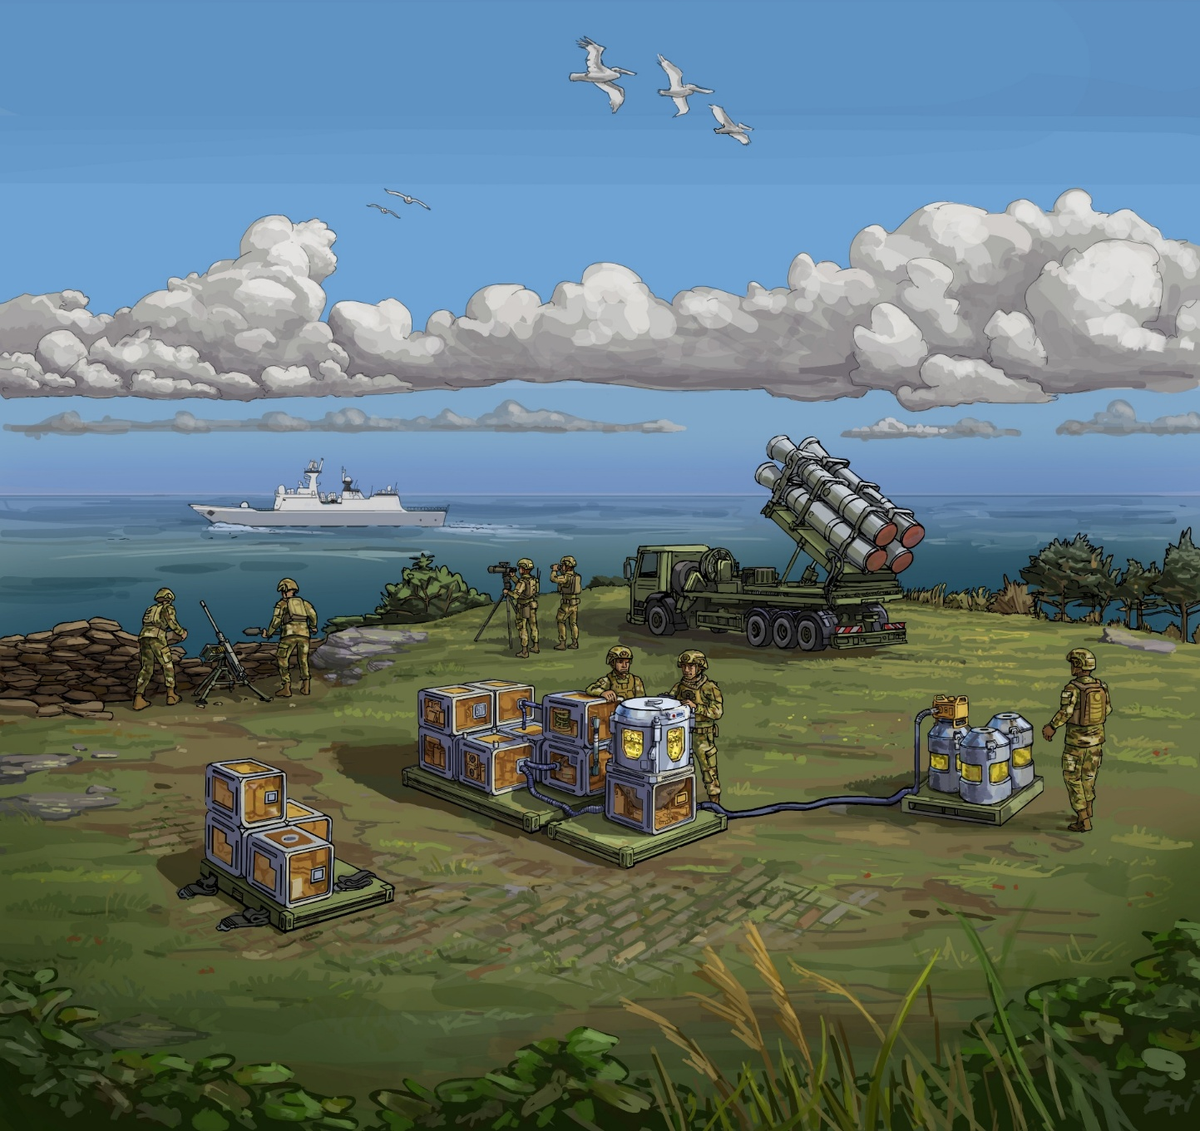

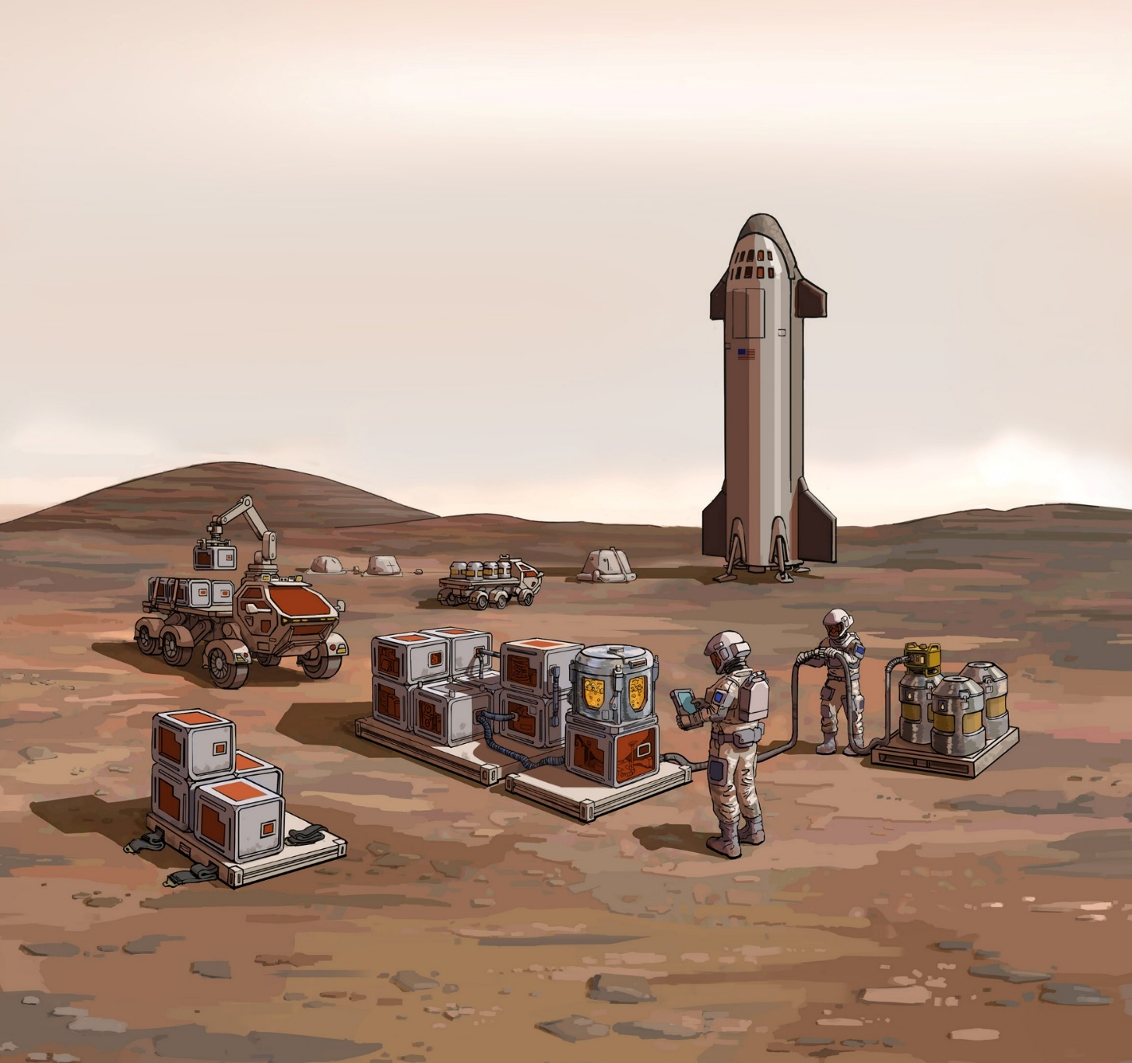
The Ability to Sustain Operations in Isolated Environments Will Be a Deciding Factor in Future Conflicts
The U.S. is falling behind in pivotal areas of emerging technologies compared to our adversaries¹
¹National Security Commission on Emerging Biotechnology. (2025, April). Charting the future of biotechnology: Final report of the National Security Commission on Emerging Biotechnology. https://www.biotech.senate.gov/wp-content/uploads/2025/04/NSCEB-Full-Report-%E2%80%93-Digital-%E2%80%934.28.pdf

Slide 3
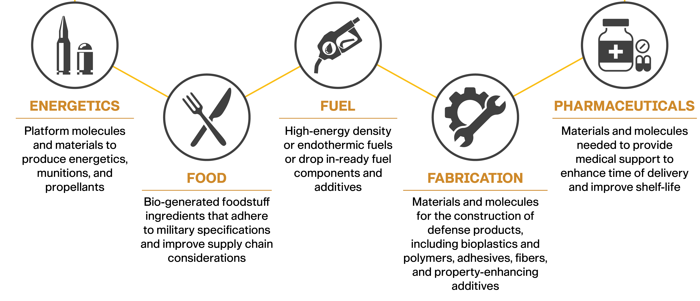
Defense Material Supply Needs

Slide 4
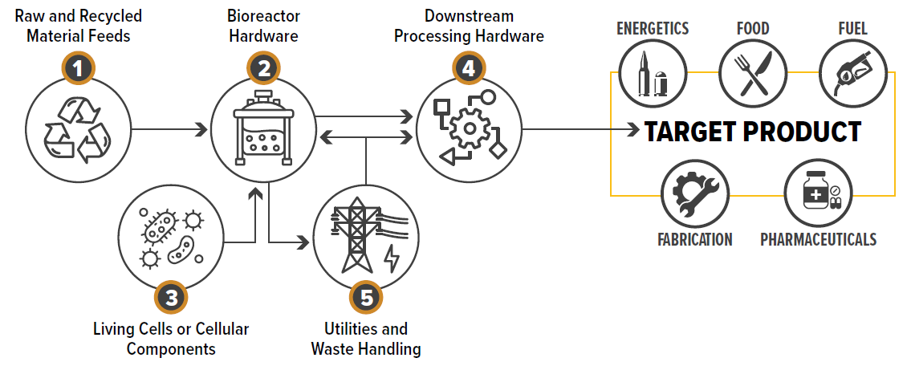
The Department of War Supports Fielding Emerging Technology
  “The Secretary [of War] shall ensure the Program supports the development and fielding of emerging technologies such as biotechnologies that provide operational and strategic advantages to the Armed forces” – National Defense Authorization Act for Fiscal Year 2026
Can one platform provide this capability at or close to point of need?

Slide 5

An Assessment of Biomanufacturing in Forward-Deployed Locations
Baseline the Technology: What is the state of the art in modular and autonomous biomanufacturing that can be deployed to support materiel production in forward operations to obviate logistical challenges?
Define the Requirements: What is needed in contested regions and austere environments? What are the required capabilities, considerations and constraints to support sustained operations?
Develop the Strategy: What is the pathway for development and deployment of modular and automated biomanufacturing platforms?
Refine the Resources: What is required to operate and validate field forward systems?

Slide 6
Considerations for Baselining the Technology
Forward Deployed Biomanufacturing refers to “capabilities, systems, personnel that are positioned at or near the point of need (tactically, geographically, or operationally) to operate with minimal reach back, under contested, resource-constrained conditions, and deliver timely mission-relevant effects.”

Slide 7
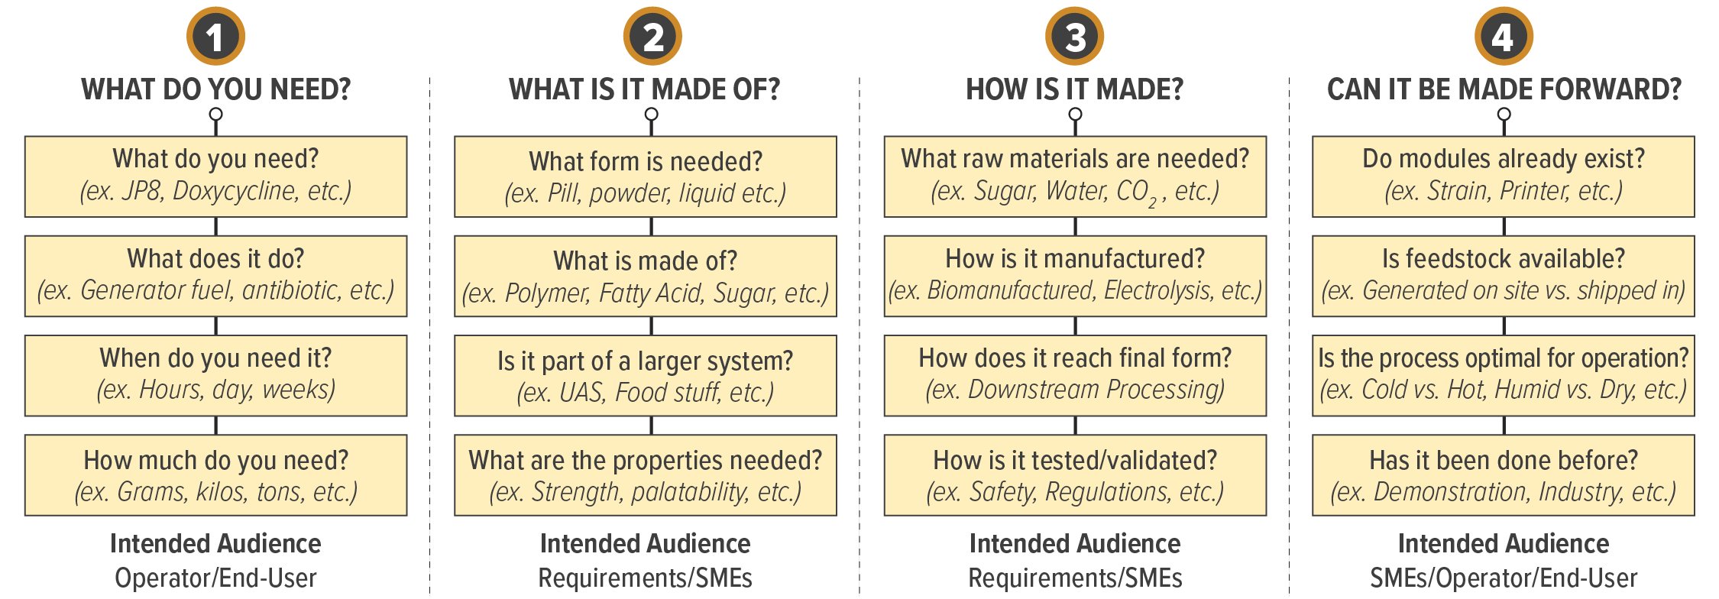
Considerations for Baselining the Technology
Forward Deployed Biomanufacturing refers to “capabilities, systems, personnel that are positioned at or near the point of need (tactically, geographically, or operationally) to operate with minimal reach back, under contested, resource-constrained conditions, and deliver timely mission-relevant effects.”

Slide 8
Considerations for Baselining the Technology
Forward Deployed Biomanufacturing refers to “capabilities, systems, personnel that are positioned at or near the point of need (tactically, geographically, or operationally) to operate with minimal reach back, under contested, resource-constrained conditions, and deliver timely mission-relevant effects.”

Slide 9
Considerations for Baselining the Technology
Forward Deployed Biomanufacturing refers to “capabilities, systems, personnel that are positioned at or near the point of need (tactically, geographically, or operationally) to operate with minimal reach back, under contested, resource-constrained conditions, and deliver timely mission-relevant effects.”

Slide 10
Considerations for Baselining the Technology
Forward Deployed Biomanufacturing refers to “capabilities, systems, personnel that are positioned at or near the point of need (tactically, geographically, or operationally) to operate with minimal reach back, under contested, resource-constrained conditions, and deliver timely mission-relevant effects.”

Slide 11
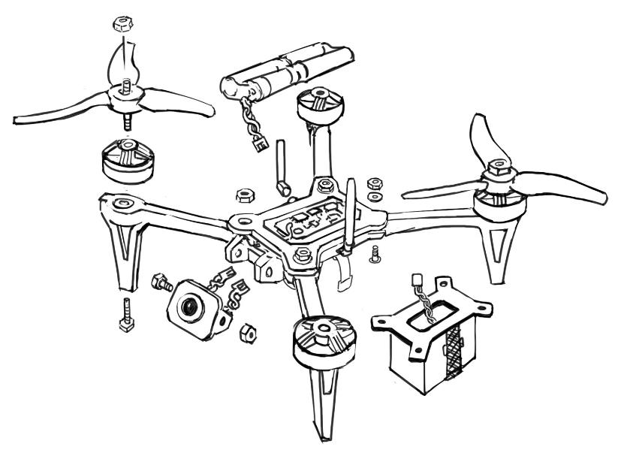
Case Study: Drone Production at Point of Need
  To manufacture a drone at the point of need, production must be broken down into its simplest components.
Lubricant*
Fixtures and Housings*
Blades*
Body and fasteners*
Fuel*
  *These highlight some of the components to drones, but do no reflect every component needed to build a drone

Slide 12
Case Study: Drone Production at Point of Need
  To manufacture a drone at the point of need, production must be broken down into its simplest components.
Lubricant*
High oleic acid oils**
Fixtures and Housings*
Polyethylene Furfural (PEF)**
Blades*
Glass-filled Nylon-5,10**
Body and fasteners*
Nylon-5,10**
Fuel*
Diesel**
Ethanol**
Hydrogen**
  *These highlight some of the components to drones, but do no reflect every component needed to build a drone
  **These components represent examples but are not the only options currently available.

Slide 13
Utilization of Biotechnologies to Manufacture Drones at Point of Need
  To manufacture a drone at the point of need, what biotechnology can contribute to the process?

Slide 14
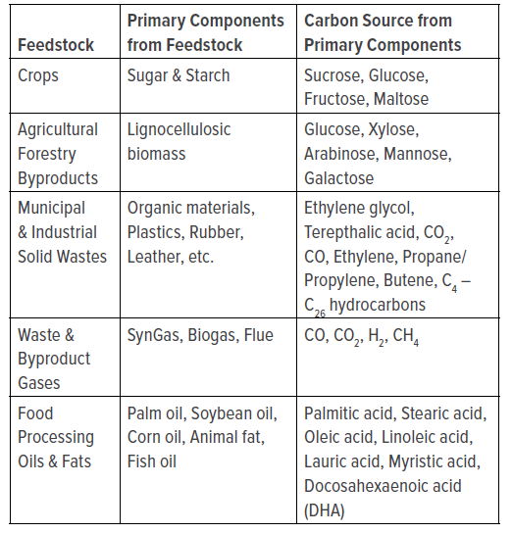
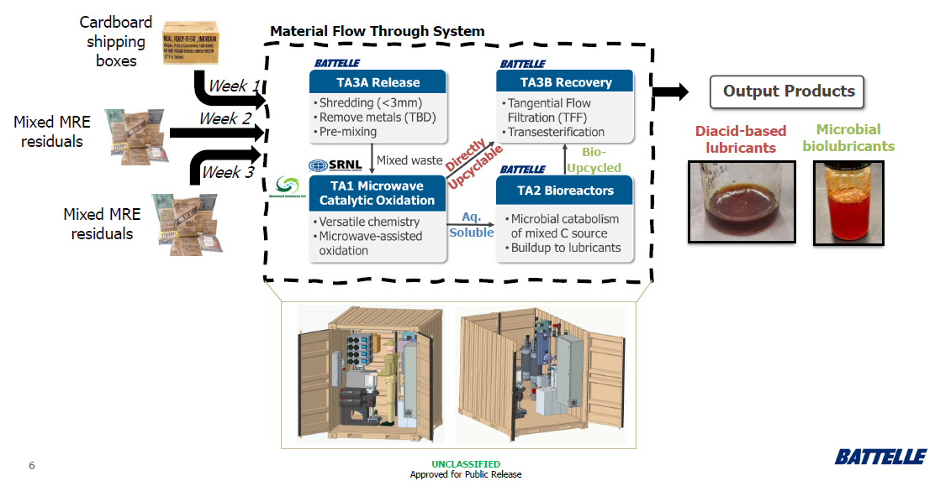
Identifying Feedstocks Further Forward
Locally sourced feedstocks (biomass, waste, CO₂, methane) can be used to produce essential materials
  DARPA ReSource Program
  Impact: Provides the warfighter the ability to recycle and reuse otherwise wasted single-use materials
  This technology is currently in the process of transitioning to DEVCOM CBC for Forward Deployed Biomanufacturing

Slide 15
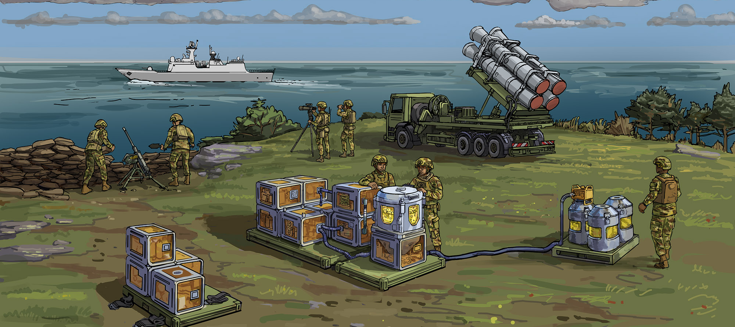
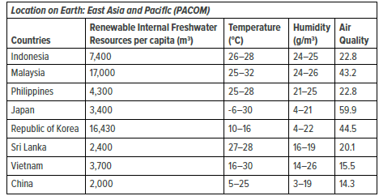
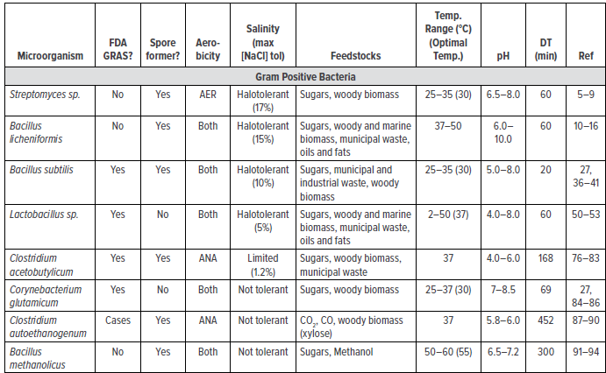
Feedstock availability informs the biology
Example: Indo-Pacific

Slide 16
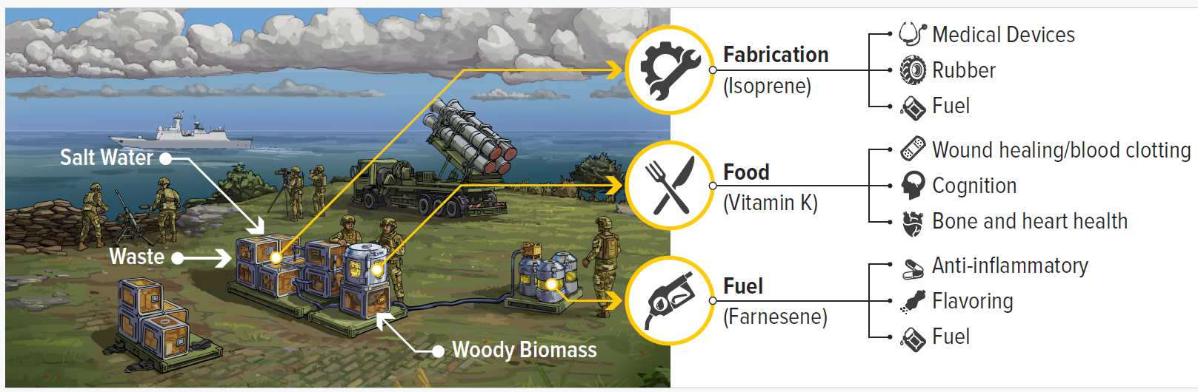
Biotechnology provides flexibility
A tailored approached allows multiple products to be biomanufactured in austere environments
Example: Indo-Pacific

Slide 17
Utilization of Biotechnologies to Manufacture Drones at Point of Need
  To manufacture a drone at the point of need, what biotechnology can contribute to the process?

Slide 18
Case Study: Drone Production at Point of Need
Combination of biomanufacturing and other advanced manufacturing technologies provide abilities to construct and assemble technology in the field.
Lubricant
High oleic acid oils
Fixtures and Housings
Polyethylene Furfural (PEF)
Blades
Glass-filled Nylon-5,10
Body and fasteners
Nylon-5,10
Fuel
Diesel
Ethanol
Hydrogen
  Items in Gold = Biomanufactured
  Items in Light Grey = Biomanufacturing byproduct
  Items in Dark Grey = Repurposed operational waste

Slide 19
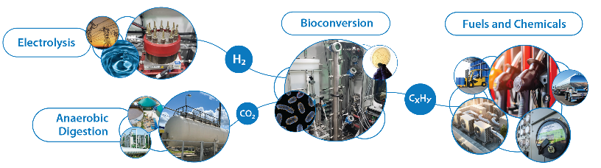
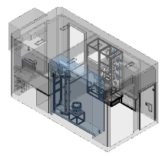
National Laboratory of the Rockies MIERA
Mobile Integrated Energy Research Apparatus
Impact: Produce energy dense fuels and chemicals anywhere, anytime
Air Source Heat Pump
Nutrient Feed
Control
Room
Thermal System
Description: MIERA is a fully integrated mobile RD&D platform enabling faster research in the field to reduce risk and the cost of biocatalytic conversion of CO₂ and H₂ to fuels & chemicals.
Today, MIERA includes solar PV, water production, grid connection, H₂ production, and biocatalytic upgrading of CO₂ to produce CH₄ anywhere and at anytime. Next steps, increase onsite electricity production and battery storage to enable standalone operation without utility grid connection.
Pressurized Gas Bioreactor
Electrolyzer stack

Slide 20
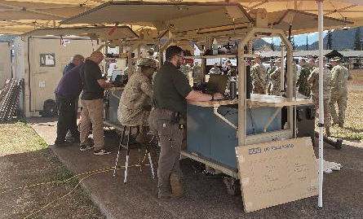
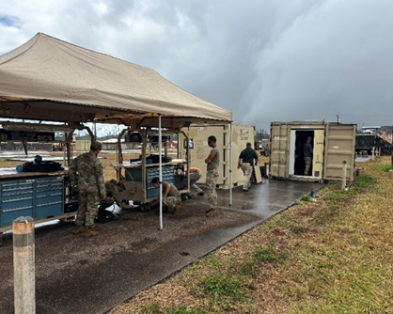
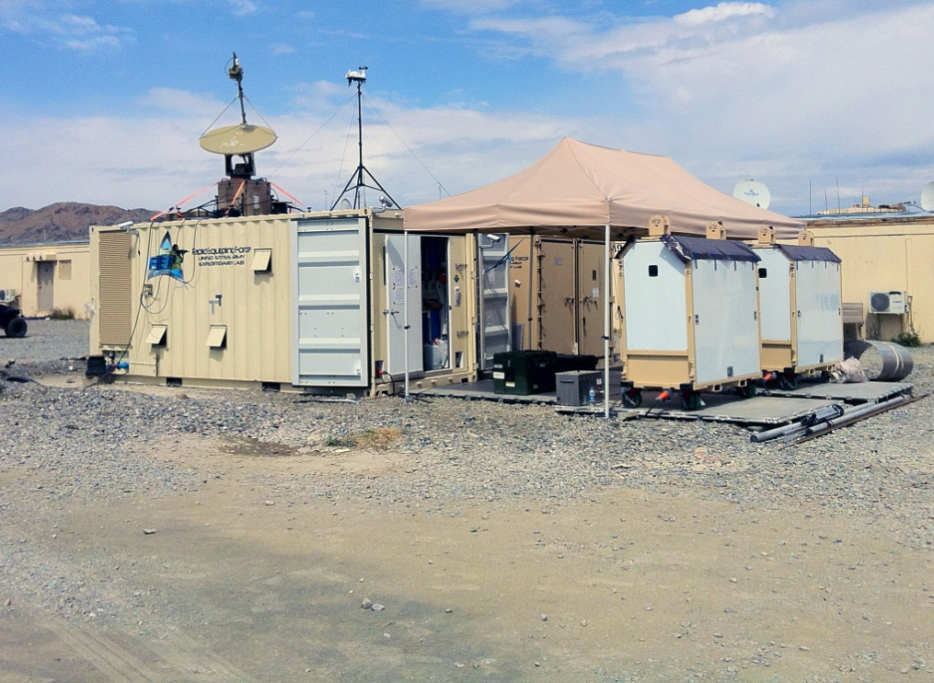
DEVCOM CBC Expeditionary Lab (ExLab)
Impact: Design, prototype and build custom solutions for urgent operational needs at point of execution
The ExLab is a custom 20-foot container containing prototyping capabilities like a Stratasys F370 3D printer, a small Computer Numerical Control (CNC) machine, a welding station, an industrial sewing machine, a 3D Scanner, and two fully equipped tool carts.
The ExLab comes with an ISU-90 capable of carrying 10,000 pounds of consumables (metal sheets, 3D printing filament, textiles).

Slide 21
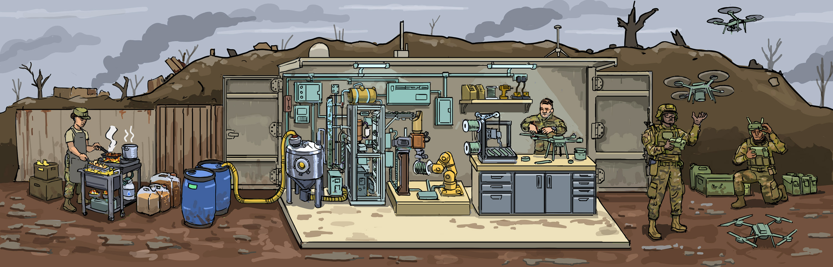
Case Study: Drone Production at Point of Need
Biomanufacturing can convert cooking oil or animal fat into biofuel, ethanol, and 3D-printed parts for drones
Nylon is a key material that’s critical for 3D-printing on demand, on location, as seen in recent conflicts globally
  Can be directly used to produce parts in the field using deployed printer systems
  Estimated need: approximately 500 g nylon per drone
370 gallons of spent cooking oil can be used to make 100 drones

Slide 22
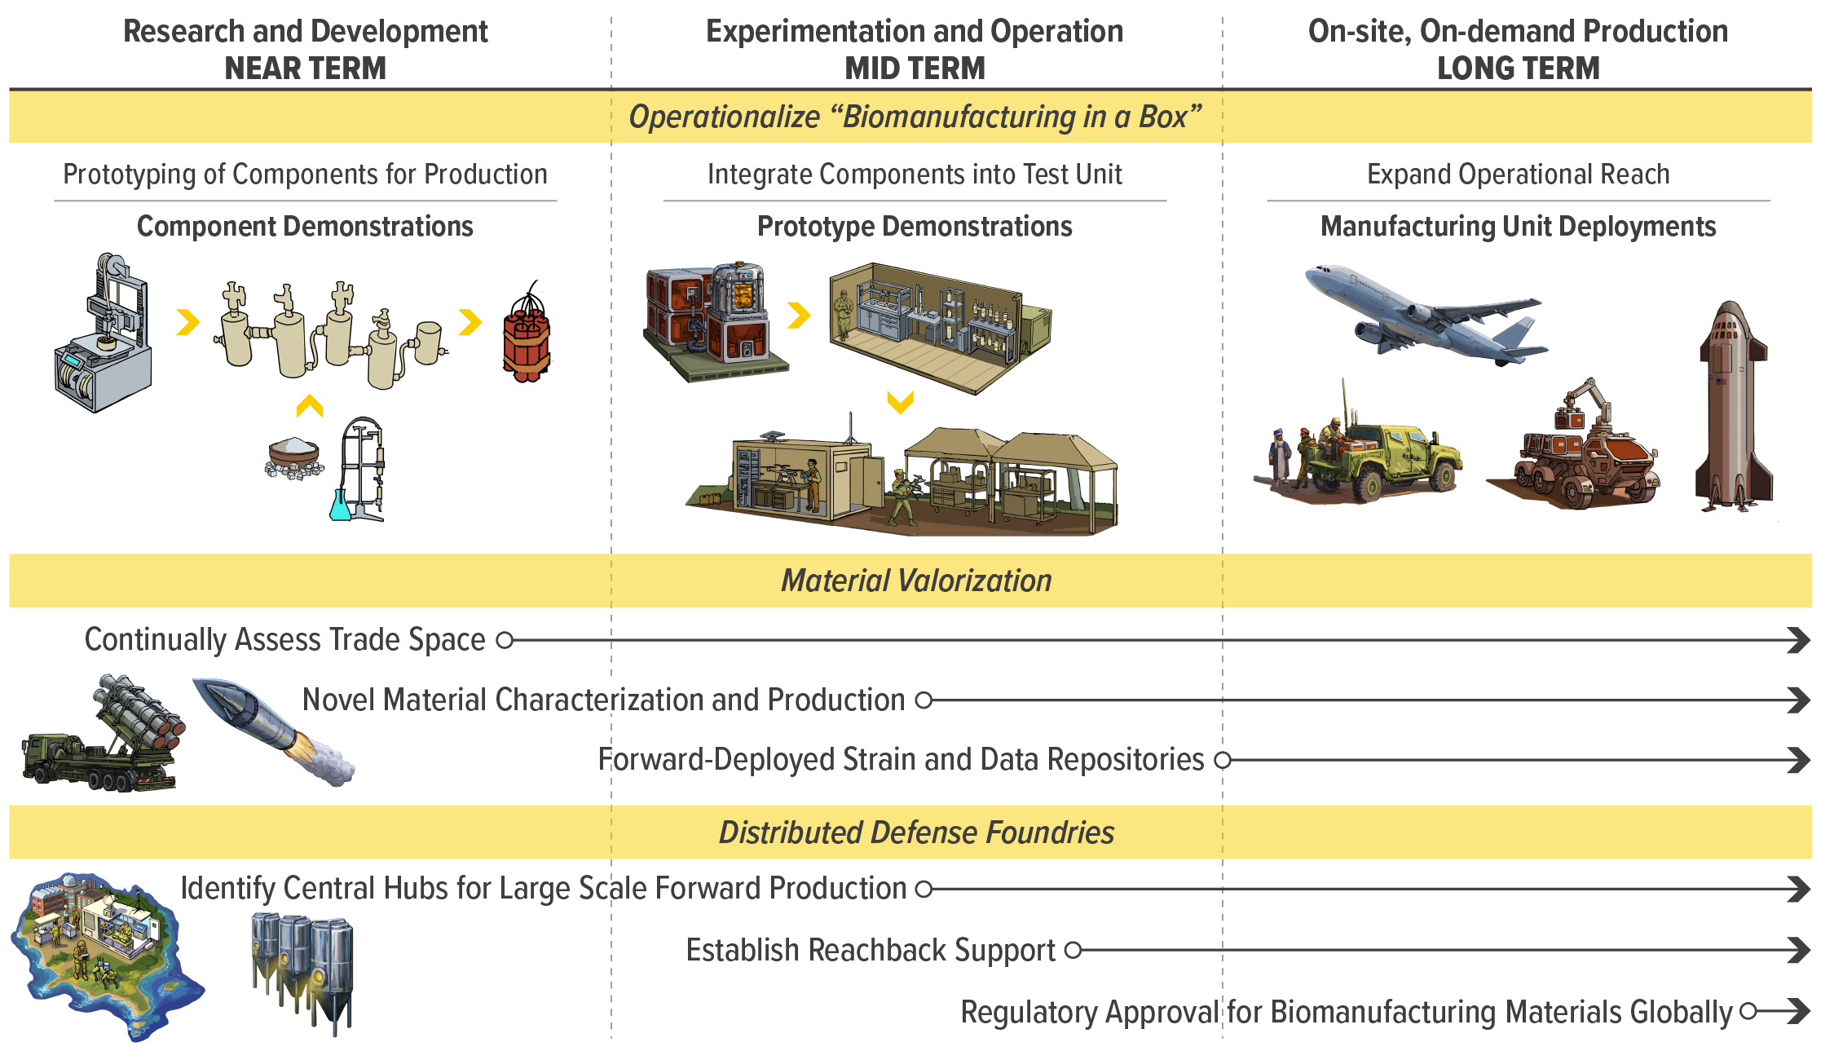
Forward Deployed Biomanufacturing Roadmap

Slide 23

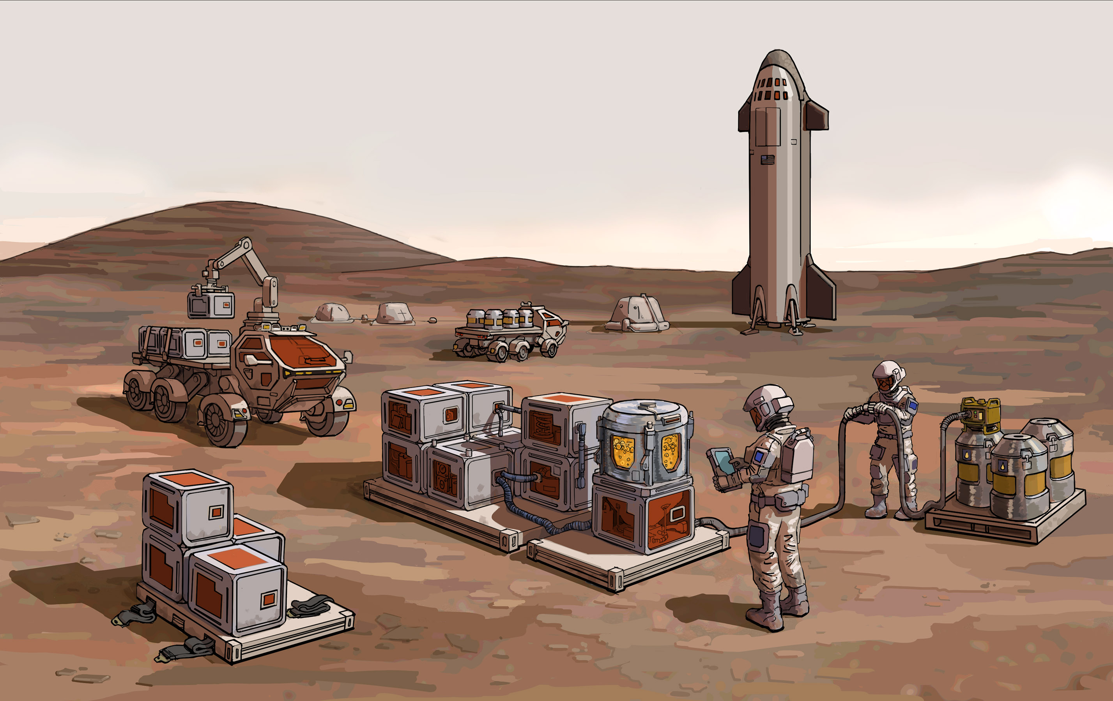
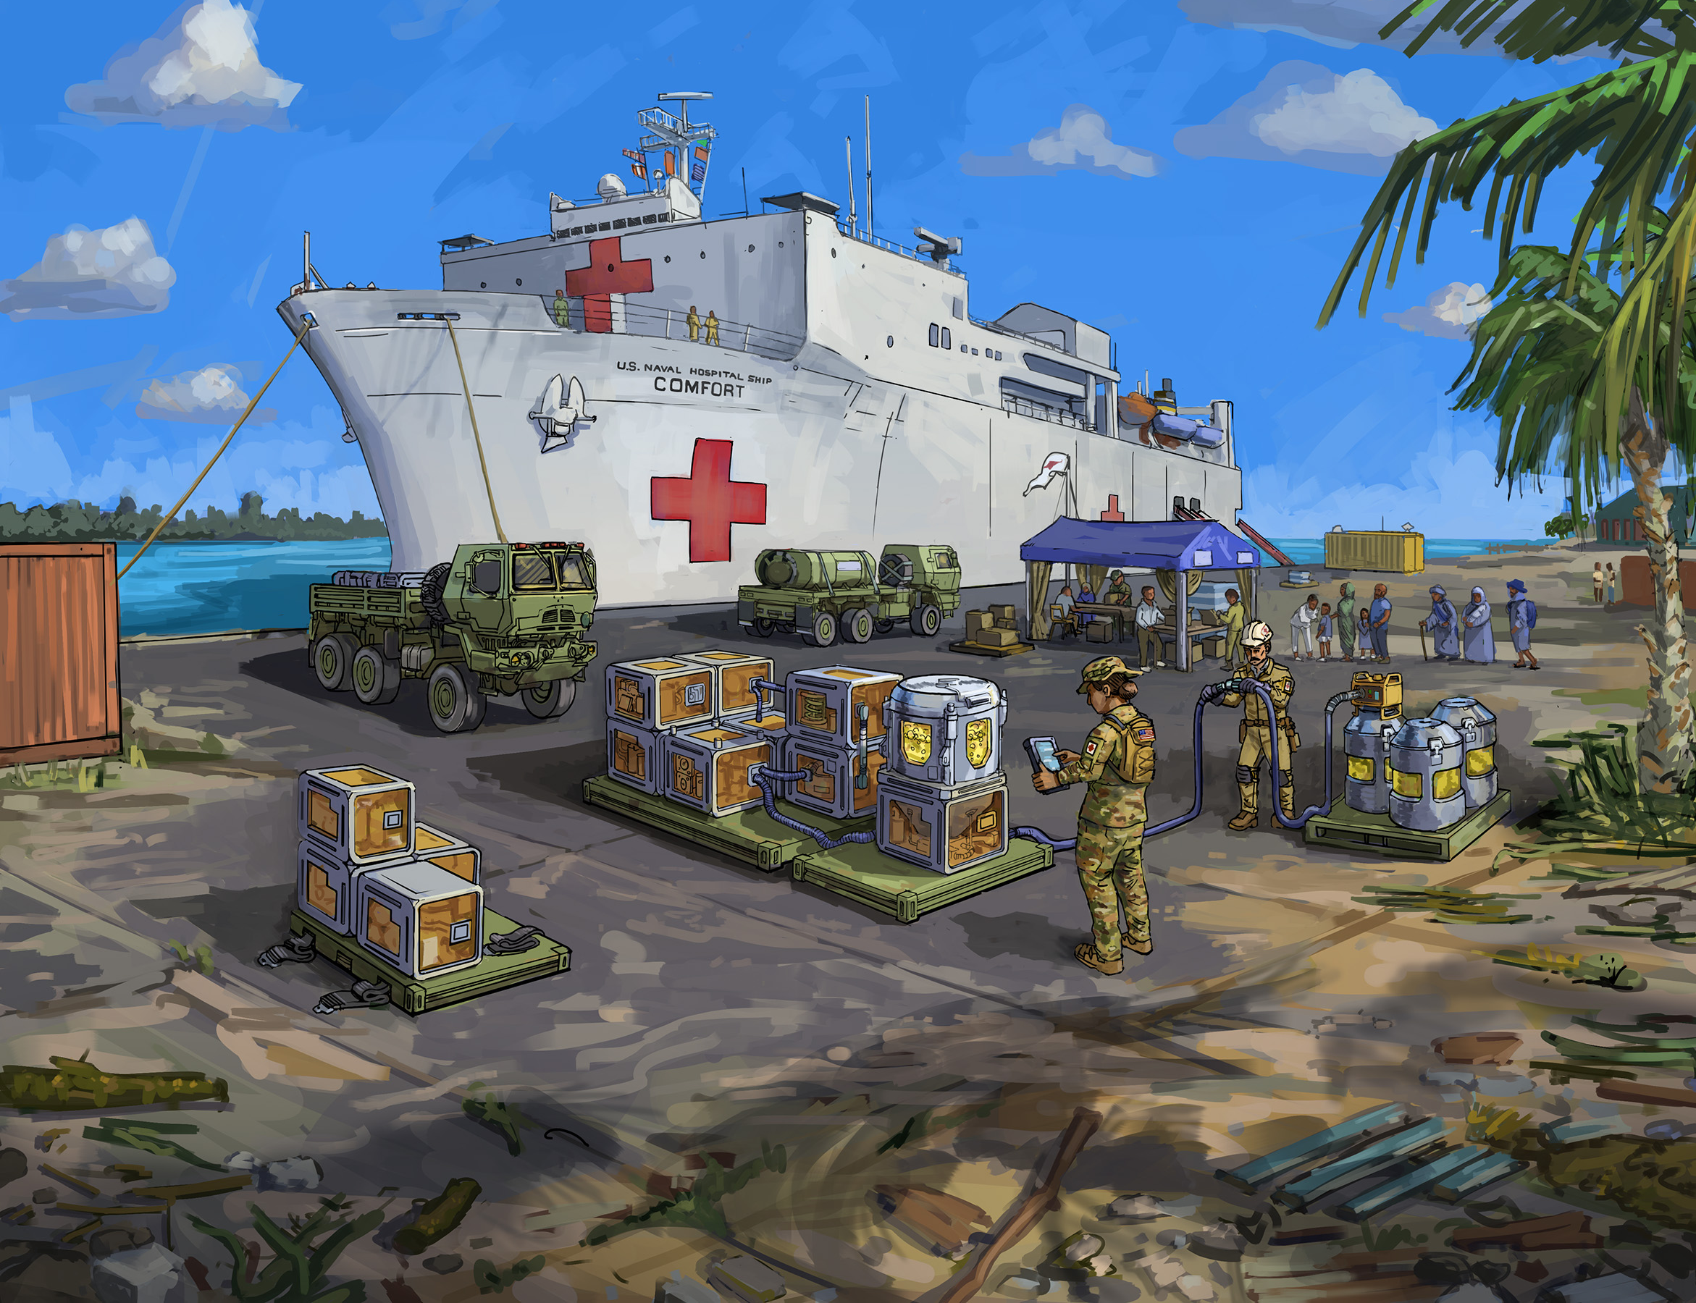
Produce Anything Anywhere At Any Time

